Slide 1
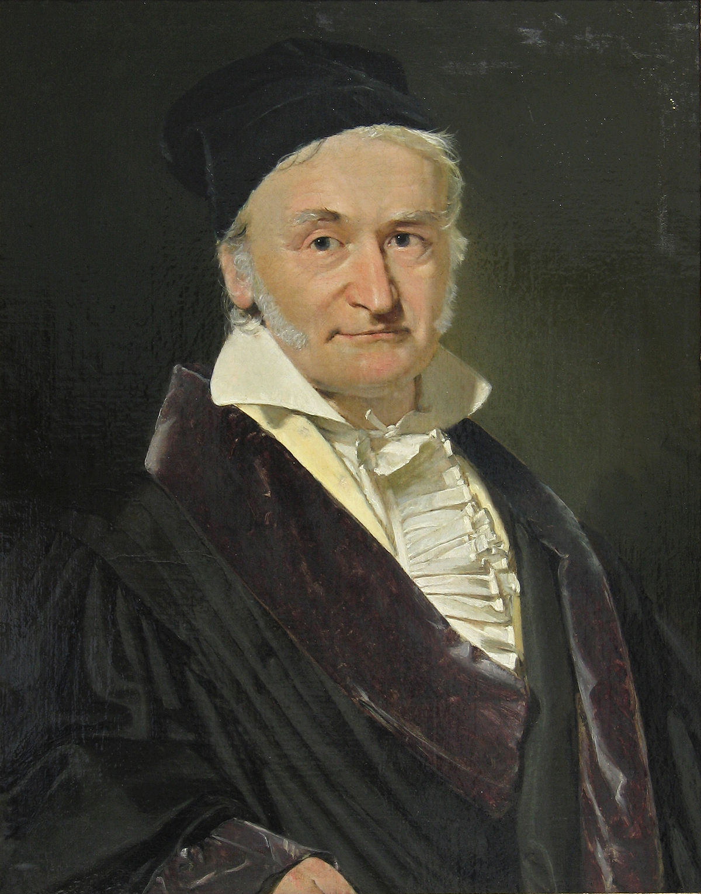
GAUSSIAN
ELIMINATION
Stability & Round-Off Errors of

Slide 2
What is Gaussian Elimination?
Method to solve systems of linear equations
Transforms the system into simpler forms until the solution becomes clear
Process involves initial setup, elimination, and back substitution
CARL FRIEDRICH GAUSS

Slide 3
HOW DOES IT WORK?
x + y - z = -2
2x - y + z = 5
-x + 2y + 2z = 1
1 1 -1 -2
2 -1 1 5
-1 2 2 1

Slide 4
HOW DOES IT WORK?
YOU GET THE IDEA
1 1 -1 -2
2 -1 1 5
-1 2 2 1
R1 + R3

Slide 5
HOW DOES IT WORK?
1 1 -1 -2
0 1 -1 -3
0 0 1 2

Slide 6
HOW DOES IT WORK?
x + y - z = -2
y - z = -3
z = 2
x = 1
y = -1
z = 2

Slide 7

WHY DO WE DO THIS?

Slide 8
WHY DO WE DO THIS?
We want a system of the form:
Ax = b
reduced to a triangular system

Slide 9
WHY DO WE DO THIS?
Row Reduction
LU-Matrix Decomposition

Slide 10
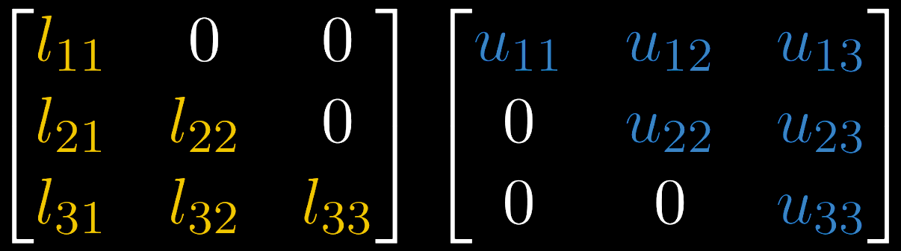
LU-Decomposition
Ly = b
Ux = y

Slide 11
LU-Decomposition
Ly = b, Ux = y, A = LU
=> Ax = LUx = Ly = B

Slide 12
Outer Product Algorithm
Gauss Transformation
o
vs.

Slide 13



Slide 14
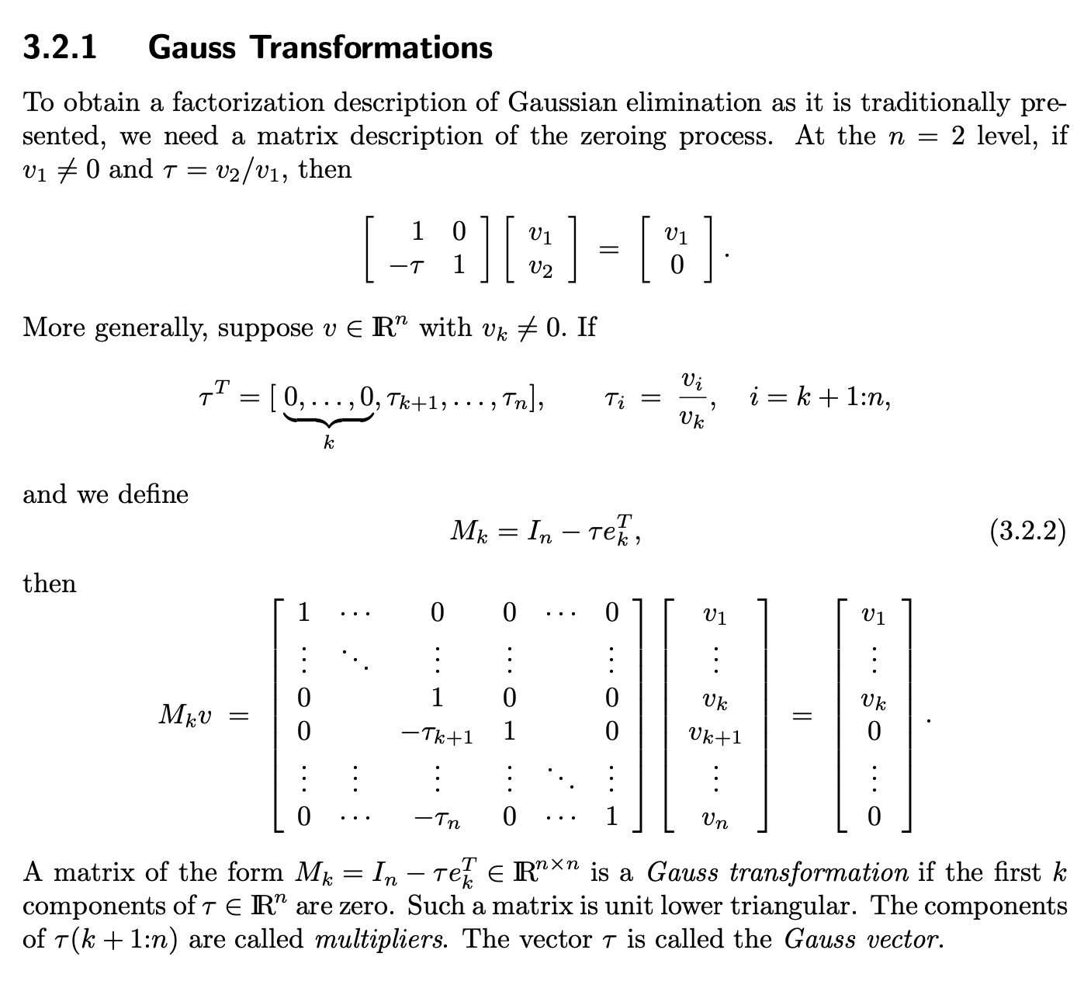
Too many computations

Slide 15


Better

Slide 16

Outer Product
Algorithm

Slide 17
A =

Slide 18
Outer Product
Algorithm
A ∈ ℝ^{n×n}, A(1:k, 1:k) is nonsingular (invertible) for k = 1: n−1.
For i = 1:n−1, A(i, i:n) is overwritten (row operations) by U(i, i:n) while A(i+1:n, i) is overwritten by L(i+1:n, i)

Slide 19
Outer Product
Algorithm
For the n x n matrix A of floating point numbers, if no zero pivots are encountered, then computed triangular matrices L, U satisfy:
􏰉􏰊
L^{ˆ}U^{ˆ} = A+H,
|H| ≤ 2(n − 1)u |A| + |L||U| + O(u²)

Slide 20
Outer Product
Algorithm
computed LU matrices
round-off error
L^{ˆ}U^{ˆ} = A+H,
|H| ≤ 2(n − 1)u |A| + |L||U| + O(u²)
error bound

Slide 21
Outer Product
Algorithm
GOAL: Optimize and minimize the error bound to make the estimation more stable
|H| ≤ 2(n − 1)u |A| + |L||U| + O(u²)

Slide 22
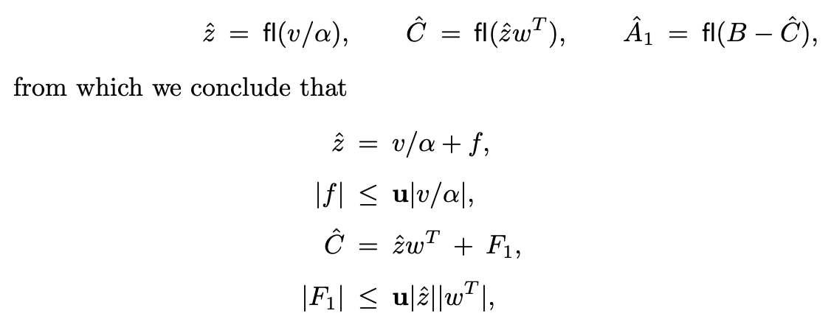

Slide 23
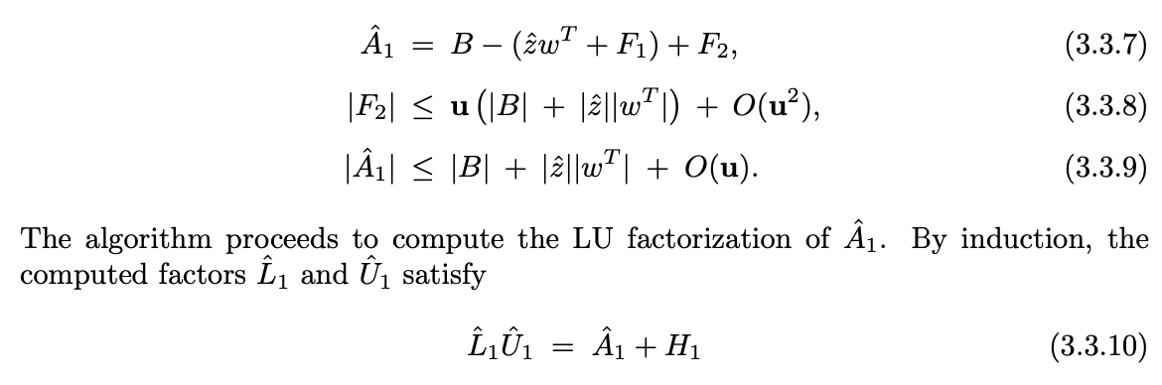

Slide 24
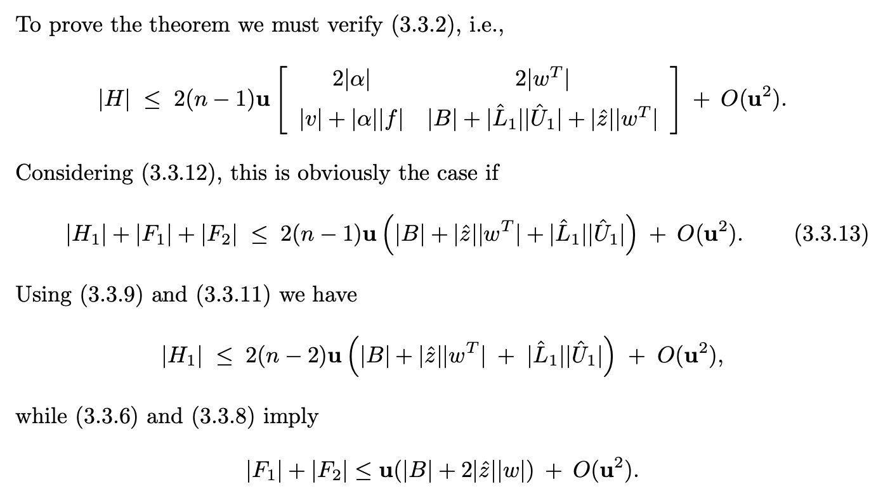

Slide 25
(induction)
|H| ≤ 2(n − 1)u |A| + |L||U| + O(u²)

Slide 26
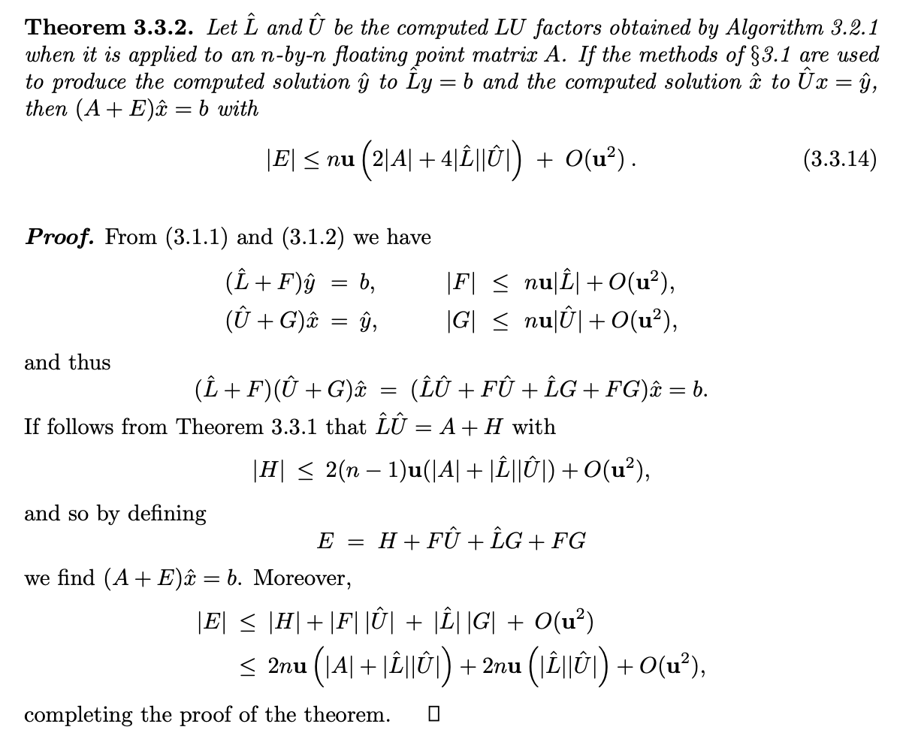

Slide 28


Even Better

Slide 29
The NEW
Algorithm

Slide 30
Outer Product
Algorithm
for k = 1:n−1, ρ = k + 1:n
A(ρ, k) = A(ρ, k)/A(k, k) A(ρ, ρ) = A(ρ, ρ) − A(ρ, k)·A(k, ρ)
end

Slide 31
[Revised] Outer Product
Algorithm
for k in range(2,n+1):
for p in range(1, k):
A[k][p] = (A[k][p])/(A[p][p])
for j in range(p+1, n+1):
A[k][j] = (A[k][j]) - (A[k][p]) * (A[p][j])

Slide 32
A =

Slide 33
7 2 3
4 5 6
1 8 9

Slide 34
1
7

Slide 35
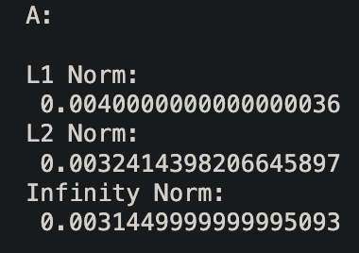
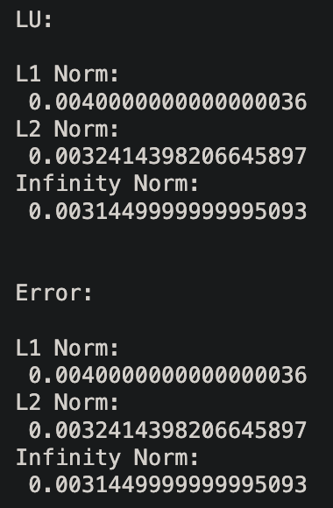
{

Slide 36
{
Smaller Error =
More Stable

Slide 37


